Slide 1






Systematical integration of public single cell datasets pinpoints TLB(T-liked B cell)
Chen-Rui Xia
Gao Lab, Peking University
June 27, 2021
Notes:
题目需要修改吗？

Slide 2
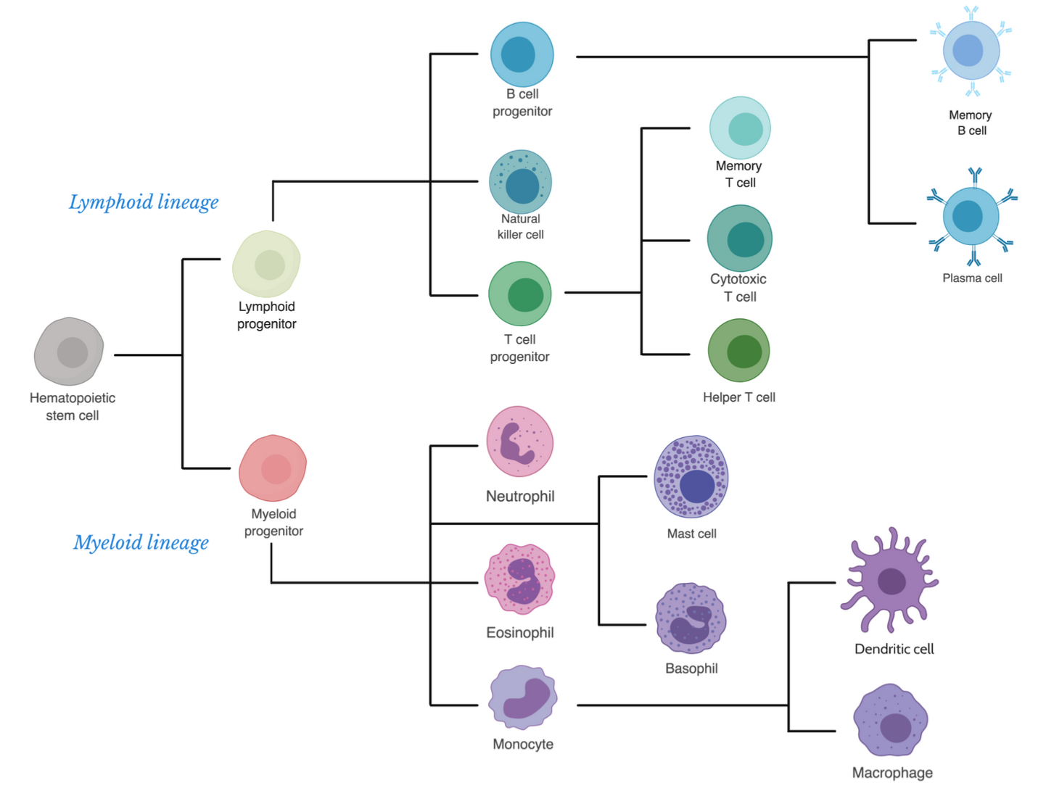
What’s the B Cell?
An important adaptive immune cell
Bethesda (2012) Immunology IV: Clinical Applications in Health and Disease
Notes:
在之前大量的研究中，人们对造血系统的分化有了清洗的了解，B cell作为适应性淋巴细胞中的一个重要分支，在机体维持自身稳态和对抗疾病或者外物入侵中发挥着独特而关键的作用。

Slide 3
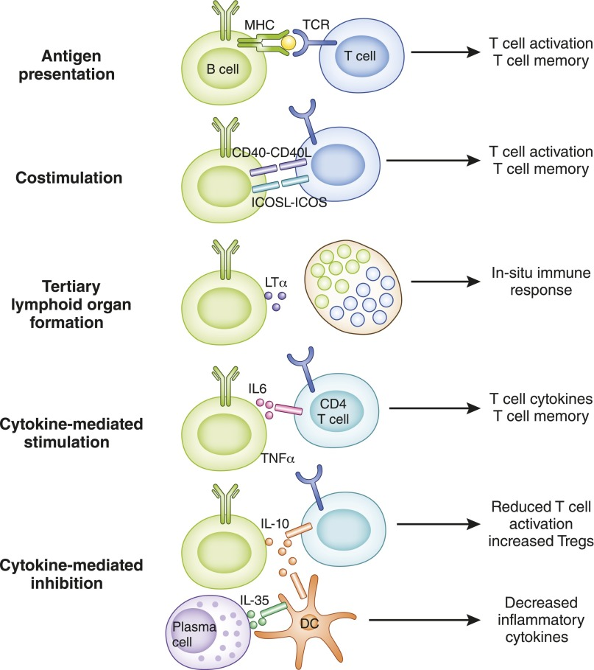
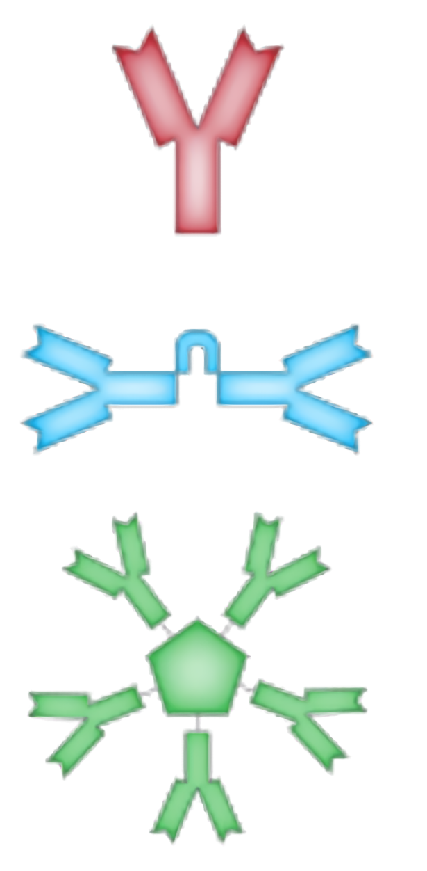
What can B cells do?
Antibody secreting
Cellular functions
Monomer
IgD, IgE, IgG
Dimer
IgA
Pentamer
IgM
William Hoffman et al. (2016) Clin. J. Am. Soc. Nephrol.
Notes:
B cell最特异性发挥作用的方式就是分泌抗体，并且应对不同需求分泌各种亚型的
此外，作为免疫系统的重要成员，B cell的细胞作用也绝对不可小视，例如APC细胞，与T 细胞之间的相互激活

Slide 4
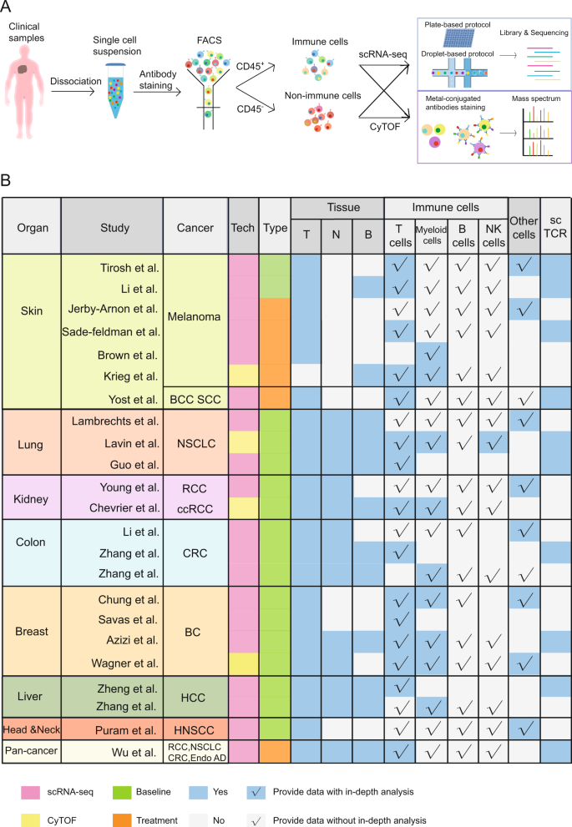
The current neglect of the importance of B cell
For example, in cancer, B cells have always existed widely, but there is a lack of in-depth research
Zhang Y et al. (2020) Cell. & Mol. Imm.

Slide 5






















High quality data with extensive coverage
UVM
oesophagus
NPC
HNSC
lymph node
blood
BRCA
NSCLC
thymus
lung
LIHC CHOL
ESCC GEJ STAD
spleen
liver
PAAD
CRC
gut
kidney
KIRC
BLCA
bone marrow
BCC
SKCM
MCC
Healthy Human(101)
Patients(467)
Notes:
有偏还是无偏的调查？数字需要更新
更正数字
我们调查了10多个健康人数据集以及30多个癌症数据集
解释一下为什么健康人和病人人数差别非常大，但是B cell数目差别不大

Slide 6
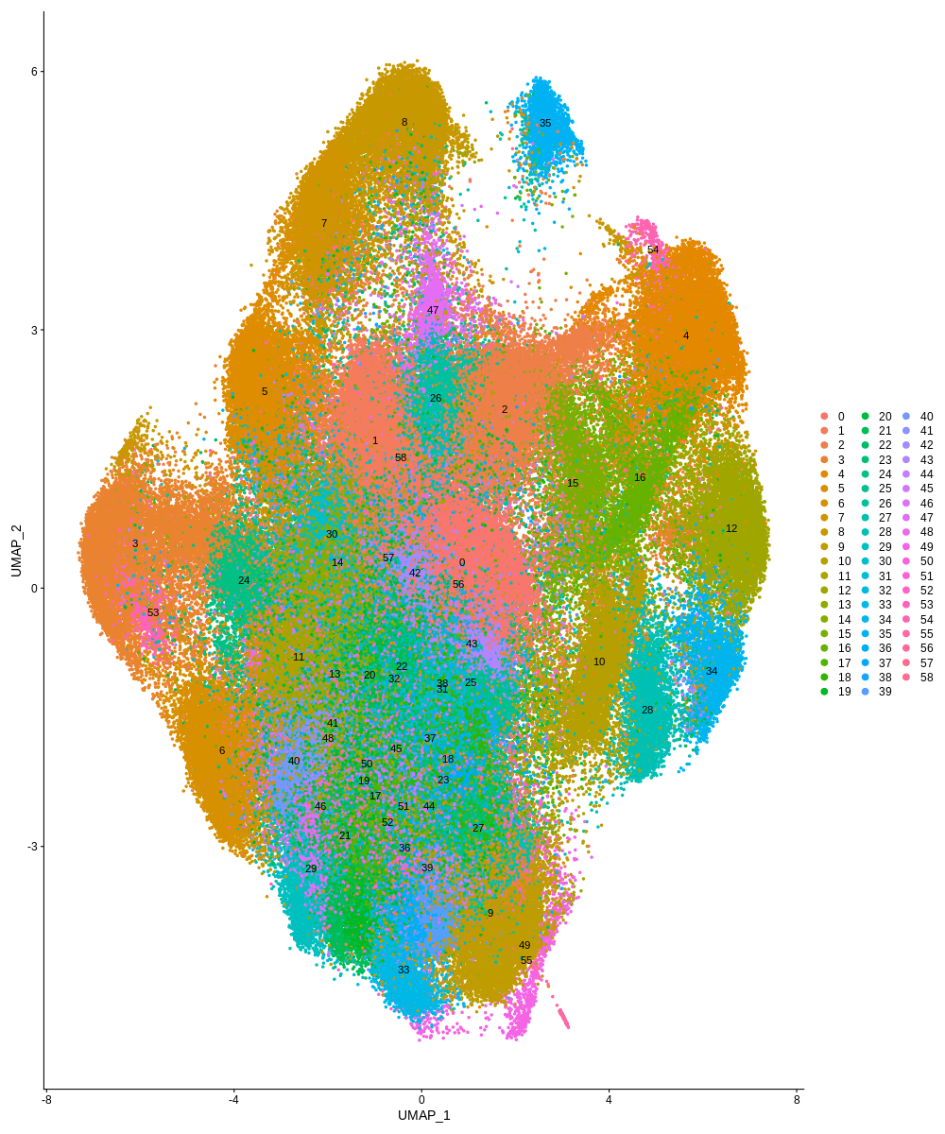
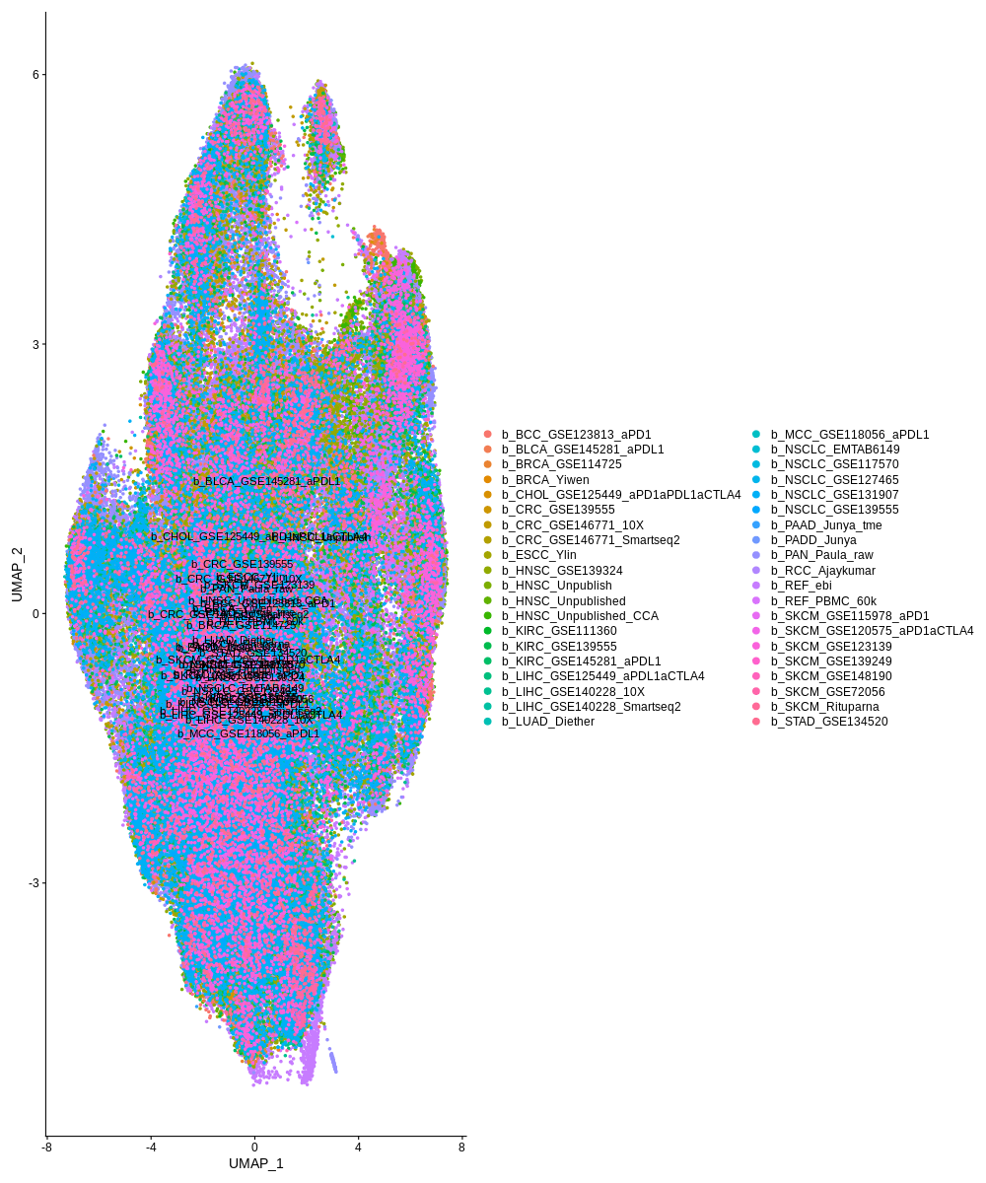
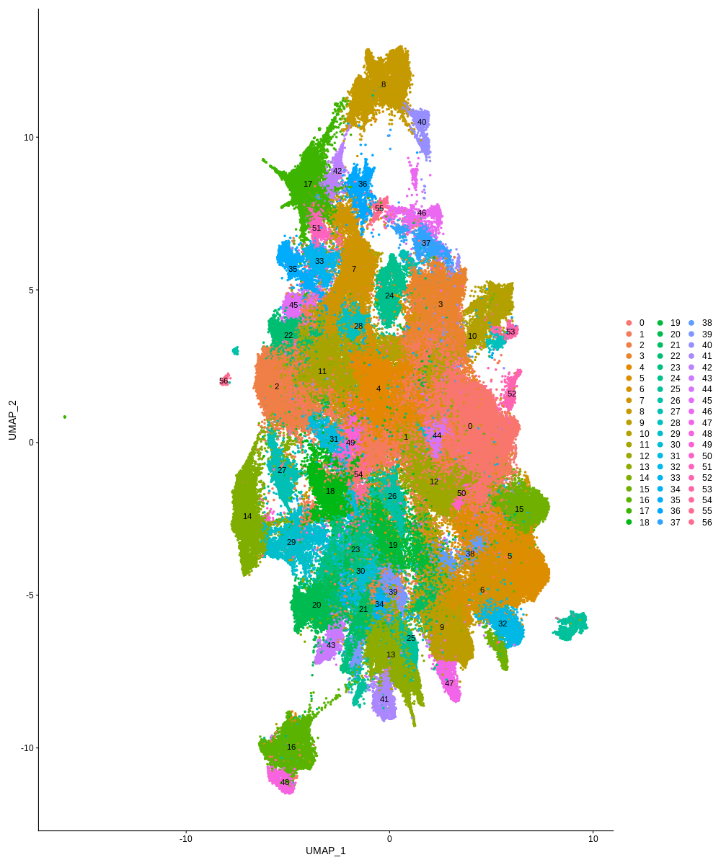

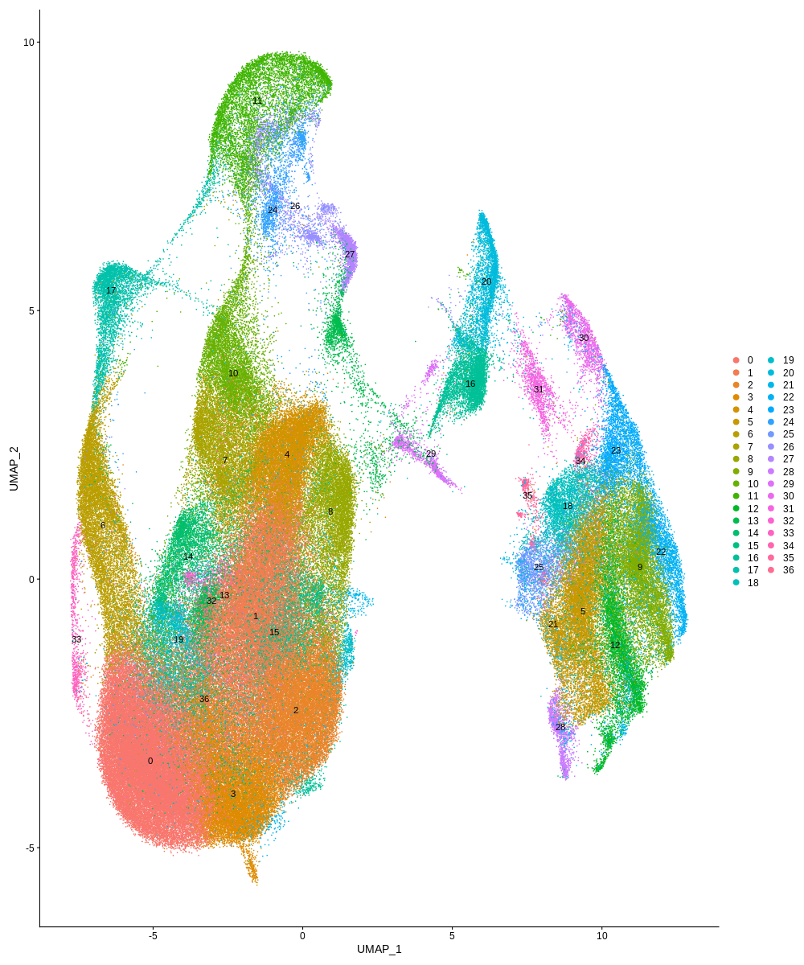
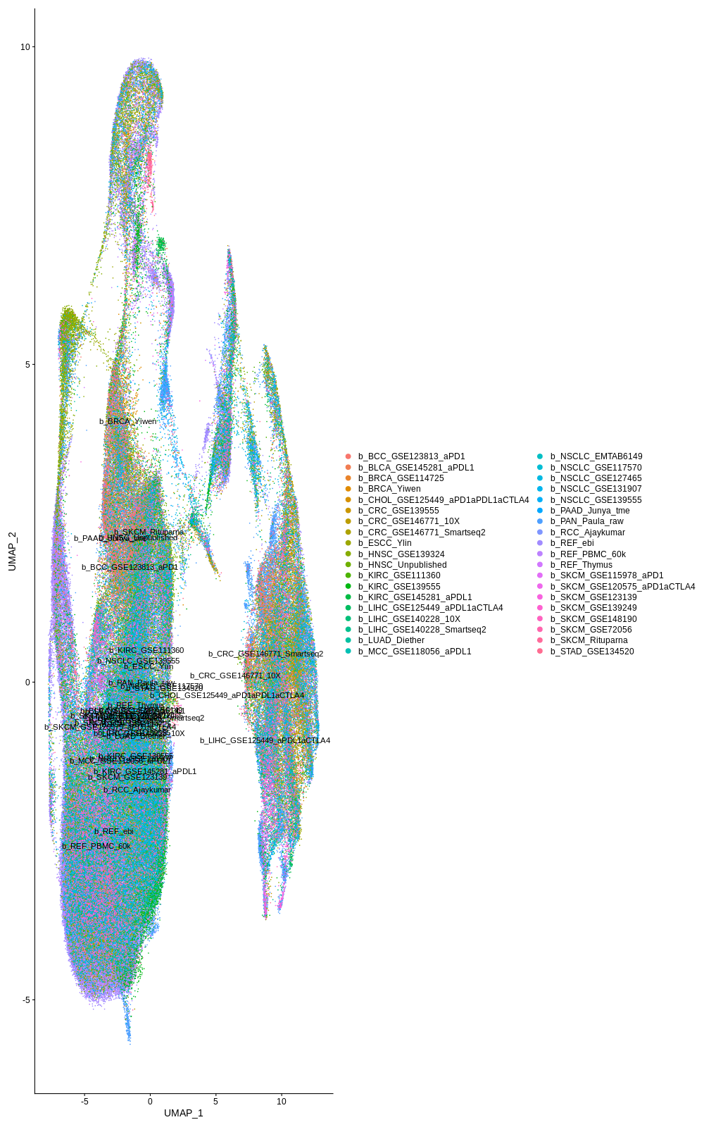
Integration, batch remove and atlas construction
Biological signal reserve
Batch remove
Harmony
fastMNN
reference-based CCA
Notes:
耗时间
粒度

Slide 7
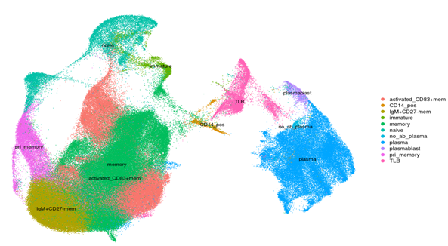
Atlas annotation and identify a non-common B cell type
CD79A
naive
immature
CD3
TLB
plasmablast
plasma
memory
V1 (250k)
Notes:
我们发现图谱中的绝大多数cluster能够与已知的B cell subtype较好的对应起来，但是我们还发现了一种新的B cell亚群，它的特征是同时表达B cell和T cell的表面marker，如CD79A 和CD3。TLB的存在与经典的免疫学相悖。为此，我们做了，我们对图谱紫自身做了全面的检查，我们更改了ref CCA所用的reference数据集，发现使用不同ref定义的亚群高度重叠，说明了图谱的稳定性质

Slide 8
TLB surface marker
Differentially expressed genes compare with T cell and B cell
TLB vs T cell
TLB vs B cell
 | p_val | avg_logFC | pct.1 | pct.2 | p_val_adj
IGKC | 0 | 3.521513 | 0.491 | 0.14 | 0
IGLC2 | 0 | 3.42403 | 0.32 | 0.06 | 0
IGHM | 0 | 2.092952 | 0.372 | 0.022 | 0
CD79A | 0 | 2.025901 | 0.803 | 0.024 | 0
MS4A1 | 0 | 1.881985 | 0.621 | 0.019 | 0
MZB1 | 0 | 1.493175 | 0.282 | 0.047 | 0
RACK1 | 0 | 1.49088 | 0.373 | 0.064 | 0
CD74 | 0 | 1.45528 | 0.968 | 0.773 | 0
CD79B | 0 | 1.217476 | 0.55 | 0.06 | 0
 | p_val | avg_logFC | pct.1 | pct.2 | p_val_adj
IL32 | 0 | 1.838164 | 0.676 | 0.065 | 0
NKG7 | 0 | 1.696757 | 0.364 | 0.047 | 0
IL7R | 0 | 1.604265 | 0.505 | 0.037 | 0
CCL4 | 0 | 1.571817 | 0.288 | 0.068 | 0
CCL5 | 0 | 1.525296 | 0.546 | 0.204 | 0
CD3D | 0 | 1.472406 | 0.6 | 0.041 | 0
CD3E | 0 | 1.359306 | 0.571 | 0.022 | 0
CD7 | 0 | 1.262557 | 0.486 | 0.022 | 0
GZMA | 0 | 1.180524 | 0.318 | 0.025 | 0
LAG3 | 7.27E-294 | -0.87874 | 0.103 | 0.254 | 6.46E-289
CST7 | 0 | -0.89718 | 0.355 | 0.529 | 0
TIGIT | 0 | -0.90365 | 0.179 | 0.348 | 0
CREM | 9.92E-240 | -0.9225 | 0.285 | 0.396 | 8.81E-235
CCL5 | 6.27E-205 | -0.9322 | 0.546 | 0.573 | 5.57E-200
CD7 | 0 | -0.93672 | 0.486 | 0.593 | 0
CD8A | 4.32E-207 | -0.95215 | 0.236 | 0.337 | 3.84E-202
CD2 | 0 | -0.95647 | 0.481 | 0.657 | 0
HSPA1A | 4.80E-213 | -0.96246 | 0.365 | 0.493 | 4.26E-208
DUSP2 | 0 | -0.97725 | 0.367 | 0.505 | 0
ID3 | 1.06E-41 | -0.36235 | 0.209 | 0.257 | 1.92E-37
OAZ1 | 0 | -0.40641 | 0.646 | 0.811 | 0
TUBA1B | 7.34E-17 | -0.44073 | 0.486 | 0.479 | 1.33E-12
CD79A | 0 | -0.47822 | 0.803 | 0.904 | 0
CD79B | 3.50E-132 | -0.52133 | 0.55 | 0.615 | 6.33E-128
VPREB3 | 1.30E-124 | -0.52244 | 0.335 | 0.416 | 2.35E-120
H3F3A | 2.20E-296 | -0.53087 | 0.419 | 0.584 | 3.97E-292
TCL1A | 1.86E-40 | -0.5559 | 0.235 | 0.273 | 3.36E-36
IGHM | 4.42E-163 | -0.62556 | 0.372 | 0.488 | 7.98E-159
JCHAIN | 1.28E-144 | -0.85209 | 0.243 | 0.359 | 2.31E-140
Blue: B cell marker; Green: T cell marker

Slide 9
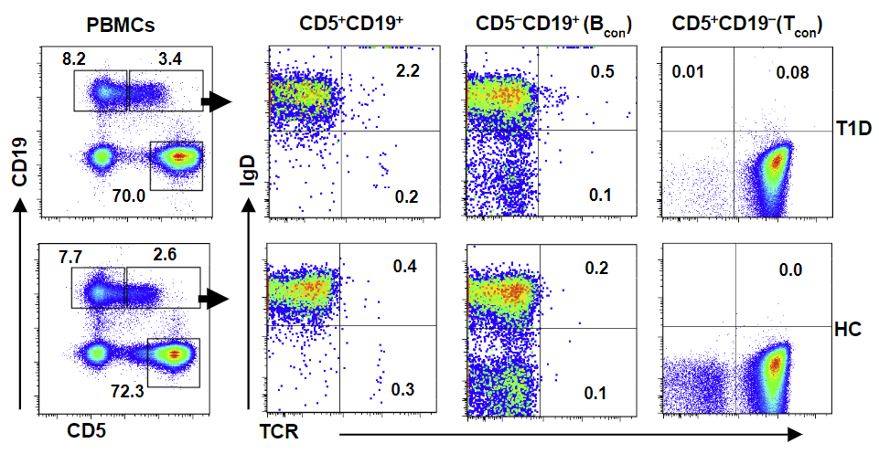
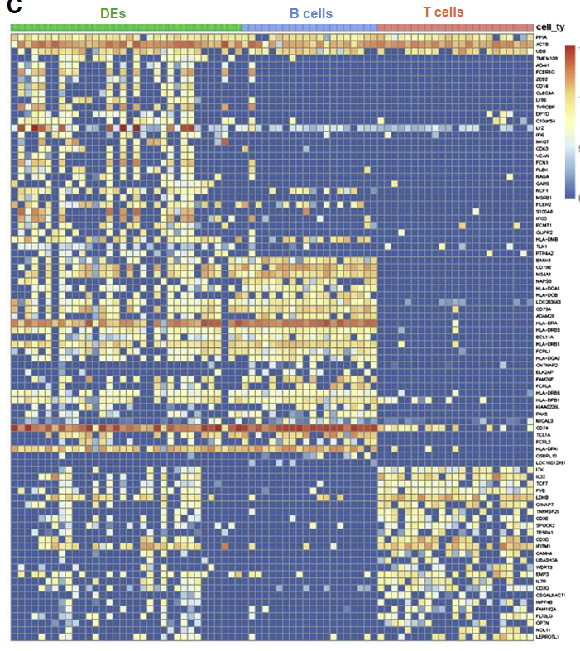
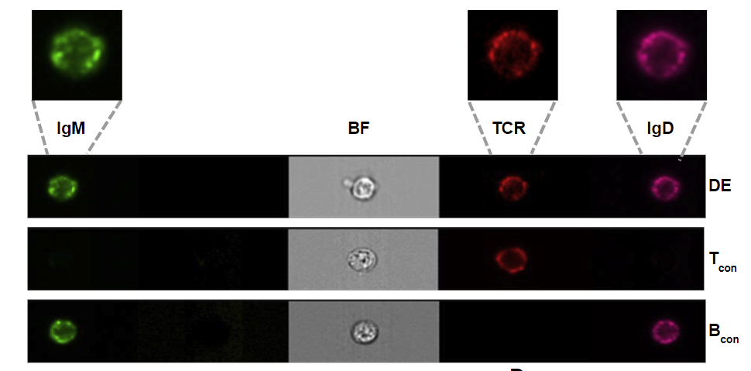
Is it artifact?——TLB existence assessment
“DE cell(X cell)” in T1D and may encodes a potent T cell autoantigen
CD5+ CD19+ TCRβ+
Ahmed R et al. (2019) Cell
Notes:
虽然我们知道CD5+ b cell 只是B cell中的一小类，但是这提示了T cell和B cell之间的界限并不是绝对的
DE细胞与自身免疫相关，但是发挥的还是B cell的 功能，
作者claim要继续从多发性硬化、类风湿关节炎找到DE细胞的可能作用

Slide 10
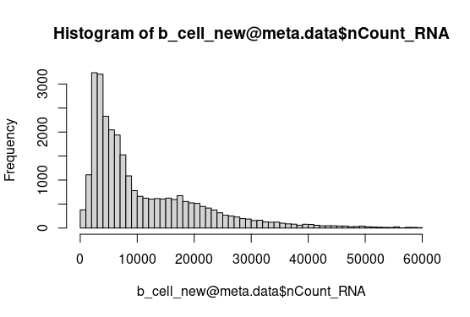
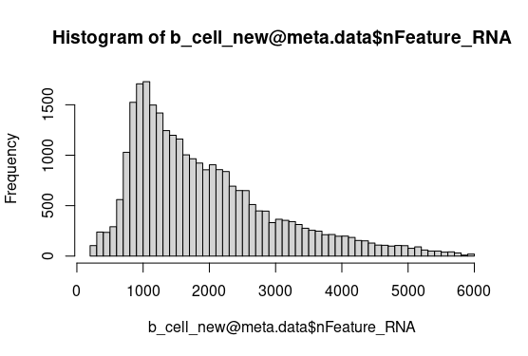
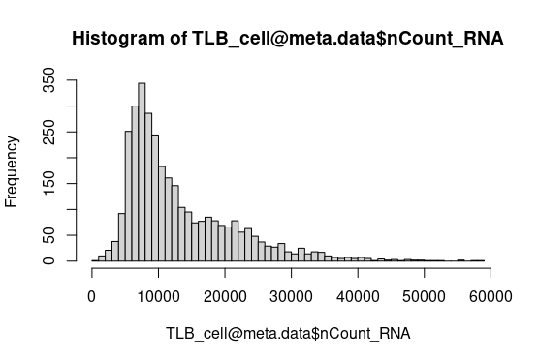
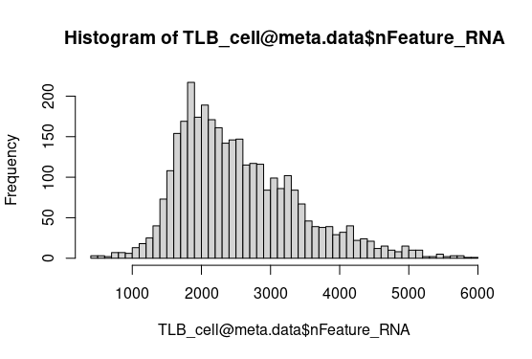
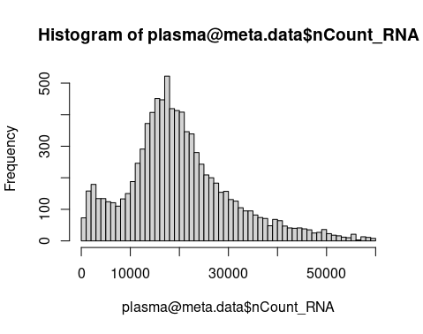
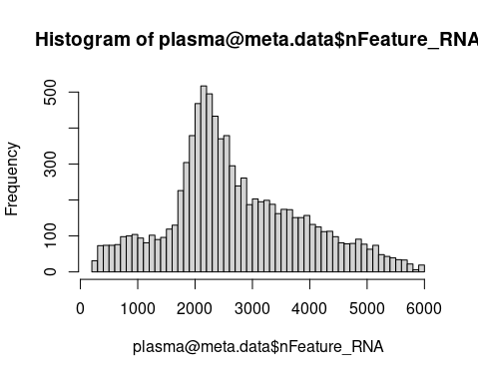
Is it artifact?——TLB existence assessment
2. Exclude the possibility of double lets
B cell
TLB
plasma
UMIs
Genes
Data from Zhao J et all. (2020) Cell Discovery
Notes:
逻辑：不是单细胞测序的时候由于技术误差出现的doublet

Slide 11
Is it artifact?——TLB existence assessment
1. Find TLB in different cancer/dataset, different sequencing protocol
platform | Dataset | b_cell | TLB | TLB/B ratio
Smartseq2 | SKCM_GSE72056 | 638 | 83 | 13.00%
 | SKCM_GSE120575aPD1 | 1666 | 21 | 1.26%
 | SKCM_GSE115978aPD1 | 887 | 84 | 9.47%
 | NSCLC_GSE127465 | 4277 | 76 | 1.78%
10x | UVM_Michael | 2487 | 388 | 15.60%
 | TME_integration | 35048 | 1502 | 4.29%
 | STAD_GSE134520 | 2035 | 25 | 1.22%
 | SKCM_GSE148190 | 694 | 42 | 6.05%
 | SKCM_GSE139249 | 331 | 23 | 6.95%
 | REF_thymus | 5082 | 291 | 5.70%
 | REF_PBMC | 7605 | 305 | 4.01%
 | REF_ebibone | 56564 | 2054 | 3.63%
 | RCC_Ajaykumar | 1952 | 114 | 5.84%
 | NSCLC_GSE139555 | 3281 | 588 | 17.90%
 | NSCLC_GSE131907 | 15588 | 308 | 1.98%
 | NSCLC_EMTAB6149 | 2554 | 132 | 5.17%
 | MCC_GSE118056aPDL1 | 571 | 52 | 9.11%
 | MCC_GSE117988aPD1 | 194 | 61 | 31%
 | LUAD_Diether | 5203 | 242 | 4.65%
 | LIHC_GSE14022810X | 4237 | 319 | 7.53%
 | LIHC_GSE125449aPDL1 | 640 | 36 | 5.60%
 | KIRC_GSE145281aPDL1 | 4376 | 335 | 7.66%
 | KIRC_GSE139555 | 7859 | 282 | 3.59%
 | HNSC_Unpublished | 7616 | 92 | 1.20%
 | HNSC_GSE139324 | 17627 | 823 | 4.67%
 | ESCC_Ylin | 19169 | 605 | 3.16%
 | CRC_GSE14677110X | 9891 | 251 | 2.54%
 | CRC_GSE139555 | 2891 | 119 | 4.11%
 | CHOL_GSE125449aPD1 | 493 | 50 | 10.10%
 | BCC_GSE123813aPD1 | 8669 | 85 | 0.98%
Notes:
不是测序误差 调整列的顺序 doplet based plate based分开 实验室来源 时间

Slide 12
Is it artifact?——TLB existence assessment
1. Find TLB in different cancer/dataset, different sequencing protocol
datasets | all | B_cell | TLB | TLB/all(%) | TLB/B(%) | chemistry | technology detail | sequence_platform
PBMC_33k | 33052 | 4363 | 217 | 0.66 | 4.97 | v1 | None | Illumina NextSeq 500
PBMC_3k | 2668 | 347 | 12 | 0.45 | 3.46
PBMC_50_50_mixture | 8040 | 611 | 39 | 0.49 | 6.38 |  |  | Illumina Hiseq2500
PBMC_6k | 5532 | 704 | 29 | 0.52 | 4.12 |  |  | Illumina NextSeq 500
PBMC_90_10_mixture | 6945 | 621 | 30 | 0.43 | 4.83 |  |  | Illumina Hiseq2500
PBMC_99_1_mixture | 8185 | 816 | 37 | 0.45 | 4.53
PBMC_donor_A_68k | 68389 | 3950 | 382 | 0.56 | 9.67 |  |  | Illumina NextSeq 500
PBMC_donor_B | 7647 | 694 | 42 | 0.55 | 6.05 |  |  | Illumina Hiseq2500
PBMC_donor_C | 9302 | 833 | 48 | 0.52 | 5.76
PBMC_4k | 4244 | 621 | 19 | 0.45 | 3.06 | v2 |  | Illumina Hiseq4000
PBMC_8k | 6027 | 972 | 34 | 0.56 | 3.50
PBMC_10k_surface_protein | 7865 | 707 | 66 | 0.84 | 9.34 | v3 |  | Illumina NovaSeq
PBMC_10k_v3 | 10959 | 1633 | 118 | 1.08 | 7.23
PBMC_5k_Next_GEM_surface_protein | 5247 | 344 | 12 | 0.23 | 3.49 |  | Chromium Single Cell 3ʹ Reagent Kits v3 with Feature Barcoding technology for Cell Surface Protein User Guide
PBMC_5k_Next_GEM | 4563 | 540 | 30 | 0.66 | 5.56 |  | Chromium Single Cell 3ʹ Reagent Kits v3
PBMC_10k_dual_indexed | 9972 | 969 | 76 | 0.76 | 7.84 | v3.1 | Chromium Next GEM Single Cell 3' Reagent Kits v3.1 (Dual Index) | Illumina NovaSeq 6000
PBMC_10k_single_indexed | 10008 | 969 | 78 | 0.78 | 8.05 |  | Chromium Next GEM Single Cell 3' Reagent Kits v3.1 (Single Index)
PBMC_5k_chromium_connect | 3642 | 460 | 17 | 0.47 | 3.70 |  | Chromium Next GEM Automated Single Cell 3ʹ Reagent Kits v3.1 | Illumina NovaSeq
PBMC_5k_manual | 4027 | 516 | 18 | 0.45 | 3.49 |  | Chromium Single Cell 3ʹ Reagent Kits v3.1
PBMC_5k_Next_GEM_2 | 4580 | 589 | 26 | 0.57 | 4.41 |  | Chromium Next GEM Single Cell 3ʹ Reagent Kits v3.1
PBMC_5k_Next_GEM2_surface_protein | 5527 | 359 | 14 | 0.25 | 3.90 |  | Chromium Next GEM Single Cell 3ʹ Reagent Kits v3.1 with Feature Barcoding technology for Cell Surface Protein User Guide
PBMC_whole_transcriptome | 9365 | 872 | 84 | 0.90 | 9.63 |  | Chromium Next GEM Single Cell 3' Reagent Kits v3.1 (Dual Index) | Illumina NovaSeq 6000
Data from 10X official website
Notes:
格子合并 不是测序出错→也不是细胞融合→一群

Slide 13
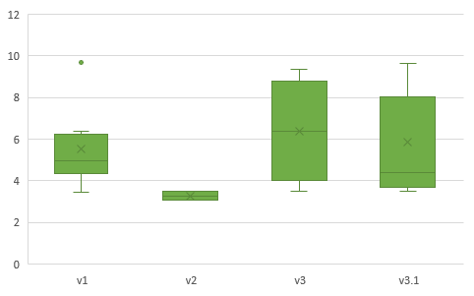
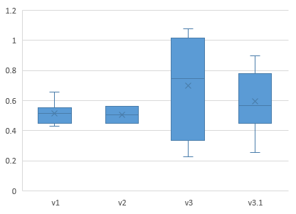
Is it artifact?——TLB existence assessment
2. Find TLB in different cancer/dataset, different sequencing protocol
TLB / all PBMC (%)
TLB / B cell(%)
Notes:
受测序细胞数量的的影响还在评估

Slide 14



Characterizing TLB
1. Confirmation of three TLB subtypes
2. Characterizing TLB with high quality, muti-omics single cell data
Transcriptional regulatory network
Surface marker
cell-cell interaction (to be done)
gene expression
surface protein
chromatin accessibility
immune repertoire
B cell atlas
Define TLB
Subgrouping
Characterizing
Notes:
然而由于技术的限制，我们无法从单个细胞中同时获得如此多的组学数据。但是我们通过对不同组学数据的整合来消除这个局限
超过了简单的profiling
1）调控网络 ——特定的转录因子以及之间的关系，controller
2）surface marker 更好定义细胞类型的组合 TCR and BCR，与生物学功能相关的蛋白 cell-cell interaction的作用
3）物种间分布的差异 如何变来的 a) 小鼠里面和人里面TLB之间的系统性差异 可能的分子差异，人特殊的基因或者疾病 b）marker 不对还是真的没有 用转录因子的组合再去scan数据
进一步的猜想，ILC相关，如何去证明或者证伪这个命题
明天的内容：重点强调一下有明确结果的事情
1）回应上次的问题：TCR and BCR
2）ID2 可能是一个重要的事情，转录因子调控网络， 功能富集——对实验验证是否有帮助，kncokin 是否可行？
3) 数据集的扩展 自身免疫的相关补充 不是unbiased——提一下
4）物种小鼠分布，用人中类似的marker 再GEO数据中没有类似的数据 对实验的指导——小鼠是不是一个好的实验对象？
NOTE：倒过来说，先说在小鼠中没有，然后说在人中分析的结果，最后说一下自身免疫病的事情
可选：ILC的问题
实验方面：对实验的需求——时间的问题，slides，周期长，
Systematical survey of single cell RNA sequencing data pinpoints a not well-known cell type which we name it TLB(T-liked B cell) possibly with subtypes

Slide 15
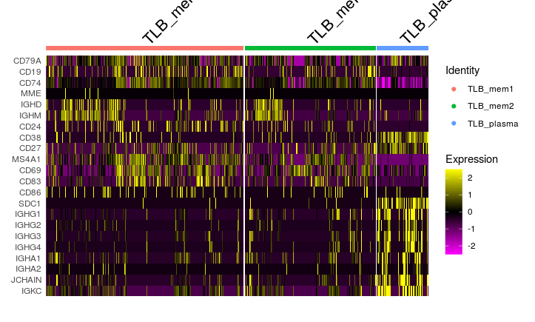
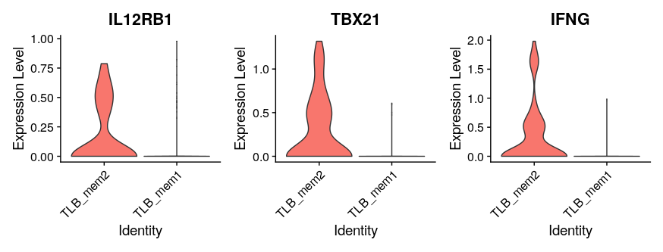
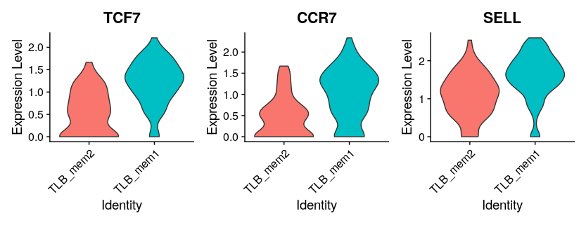
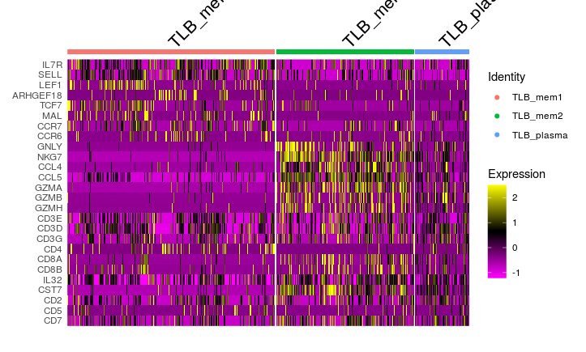
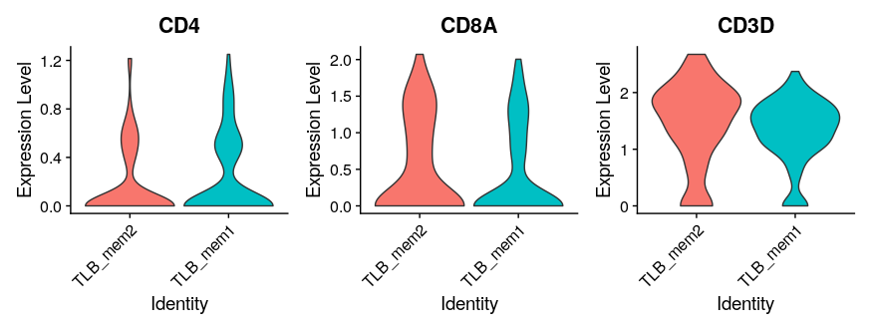
TLB subgrouping
TLB_mem1, TLB_mem2 and TLB_plasma are different in expressing B cell and T cell marker
TLB_mem1
TLB_mem2
TLB_plasma
memory B marker
plasma marker
helper T marker
cytotoxic T marker
Notes:
这个图片之后会替换，但是现在来不及了

Slide 16
Single cell muti-omics data
Cell typing
trajectory
RNA
Surface protein
ATAC
ATAC: key gene accessibility
SCENIC: key TFs activity
RNA: global landscape
Surface Protein: markers for sorting
Cell-cell interaction: potential function
Key TFs
Cell chat
Cell chat
Gene open area
Notes:
先说结论

Slide 17
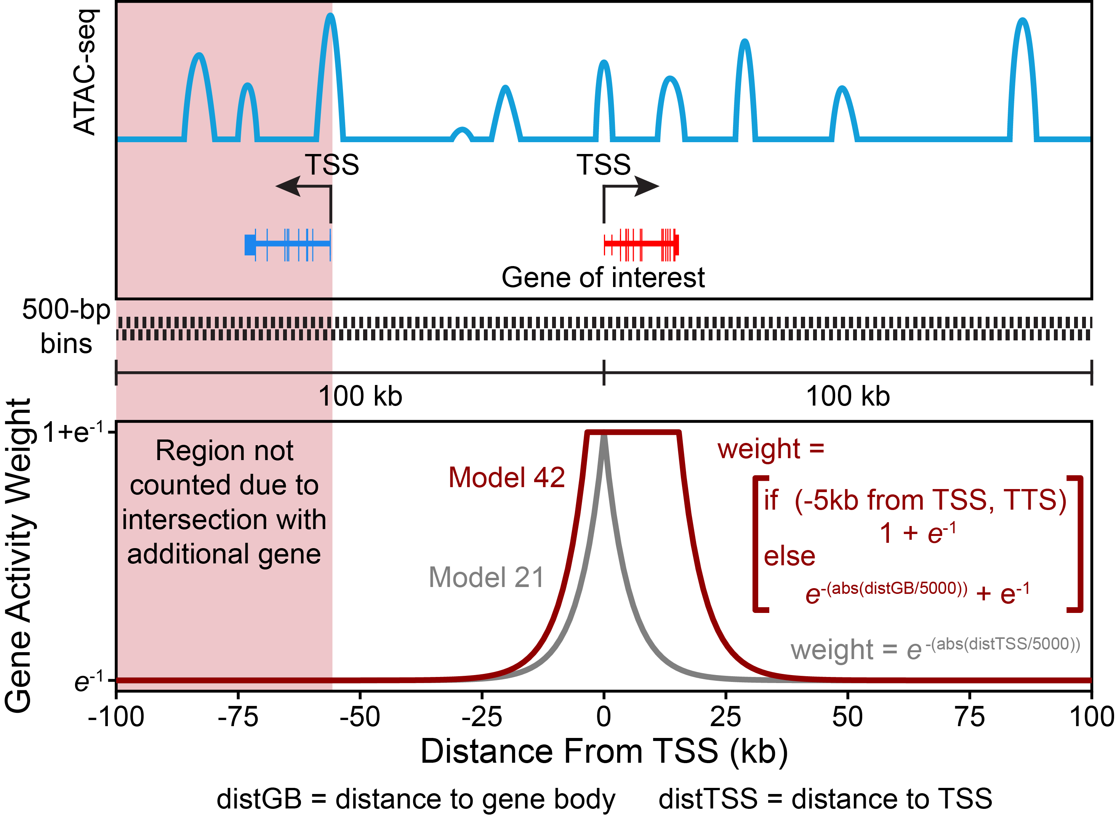
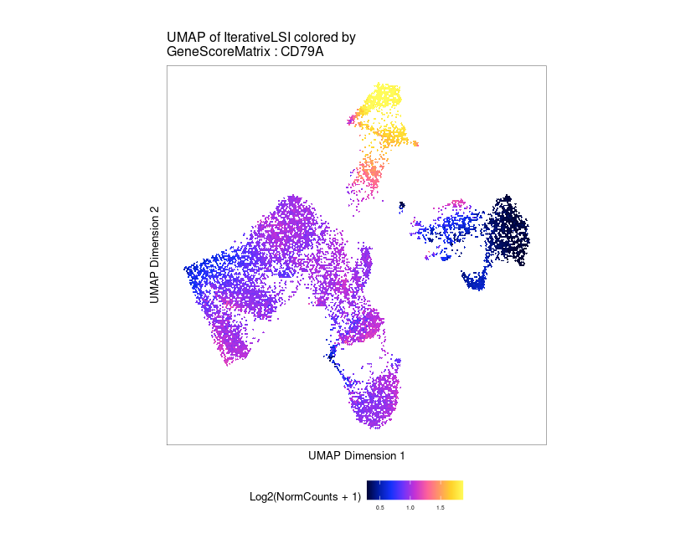
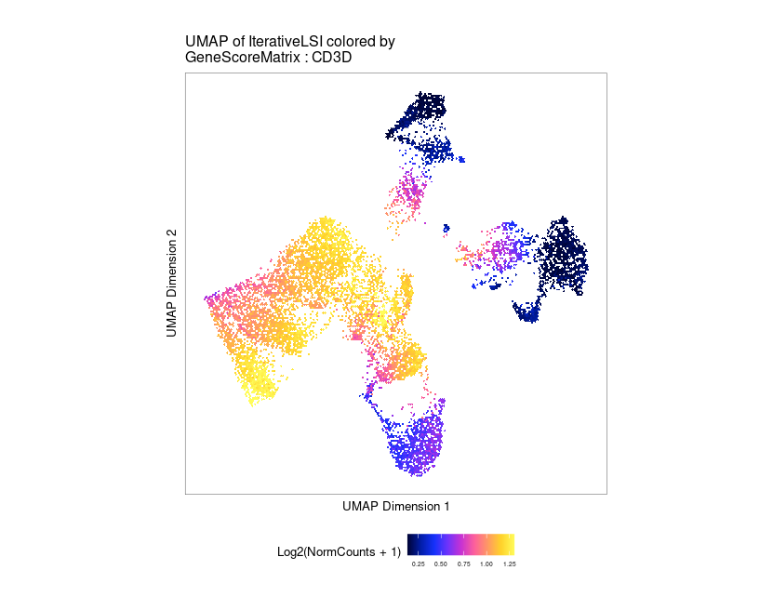
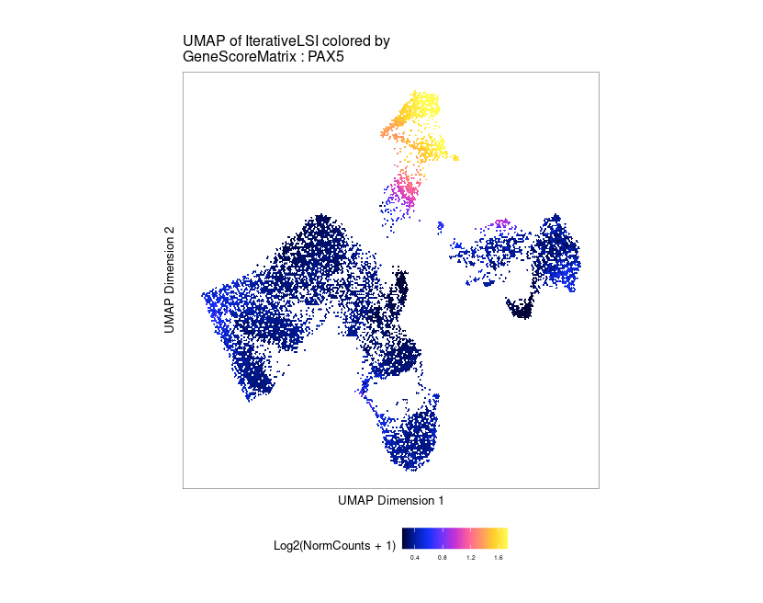
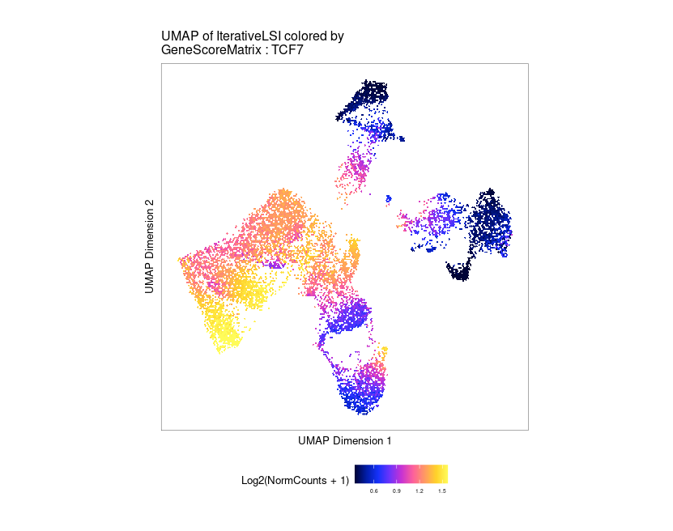
Transcriptional regulatory network——chromatin accessibility
CD79A
CD3D
B cell
TLB
T cell
Granja et al.(2021) Nat. Gen.
PAX5
TCF7
Show how to calculate the GeneScore from the original peak
TLB cells can be detected at T-B boundary by scATAC data by their intermediate transcriptional activity on some T/B markers.
Notes:
是否需要加上对每个组学的介绍
ATAC中的dropout的影响更大一点
ATAC-seq的作用主要是补充转录因子的表达量数据，因为在scRNAs-seq中TF的表达量往往很低
但是转录区域开放并不一定代表能表达
全体的pbmc数据 补充一张图片

Slide 18
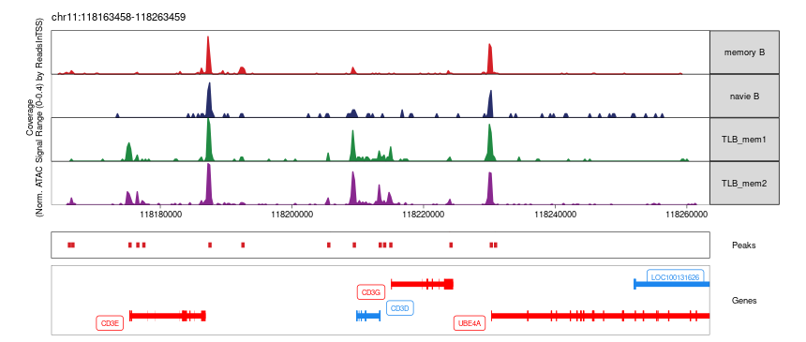
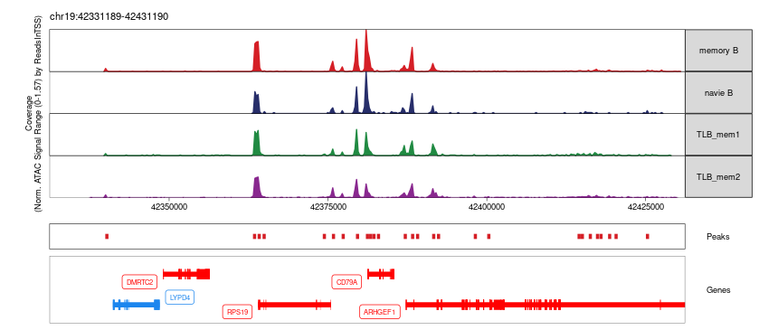
Transcriptional regulatory network——chromatin accessibility
Verification the correlation between GeneScore and peak
CD3 gene group
CD79A
Notes:
此外ATAC-seq也嫩可视化关键位点的染色质可接近性，注意要加上T cell一起比较，最好能加上NK细胞，

Slide 19
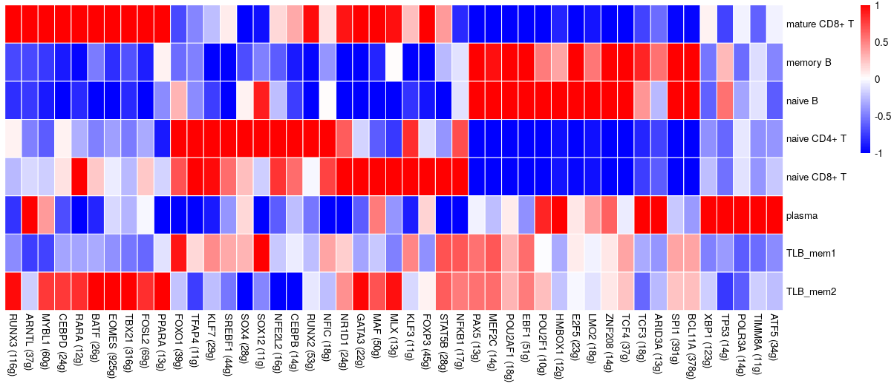
Transcriptional regulatory network——SCENIC
By calculating the TF activity(not expression). We find TLB have lower activity in some B cell key TFs such as EBF1 and PAX5,but have higher T cell specific TFs activity, and TLB_mem1 and TLB_mem2 have differences too.
RUNX3
TBX21
RUNX2
GATA3
STAT5B
PAX5
EBF1
BCL11A
POU2AF1
Notes:
简单介绍一下SCENIC的原理，基于随机森林找到共表达，motif富集来剪枝 AUC 得到每个cluster的打分 ID2
需要加入ILC中的关键转录因子来对比（RORA）,但是这个对比也仅仅是相对于B cell的
补充一张图 三个圆圈

Slide 20
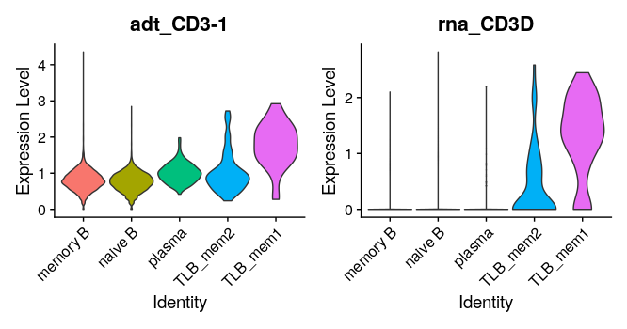
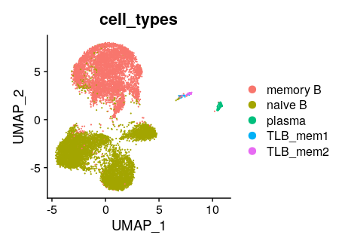
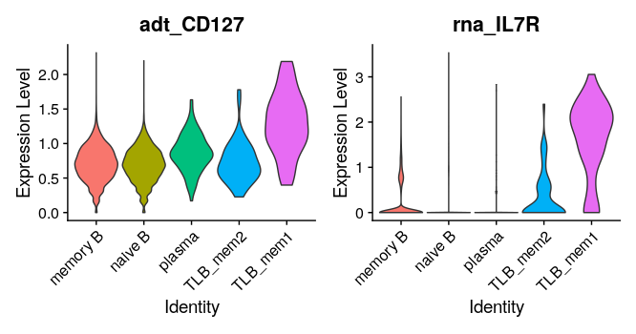
Surface protein
TLB_mem2
TLB_mem1
Notes:
需要通过表面蛋白来说明TLB_MEM和TLB_mem2的区别
P均小于0.05

Slide 21
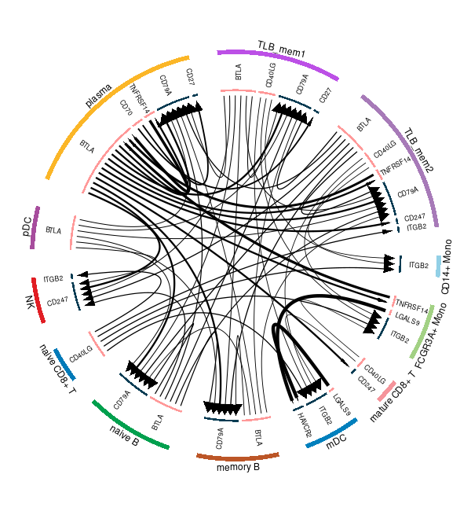
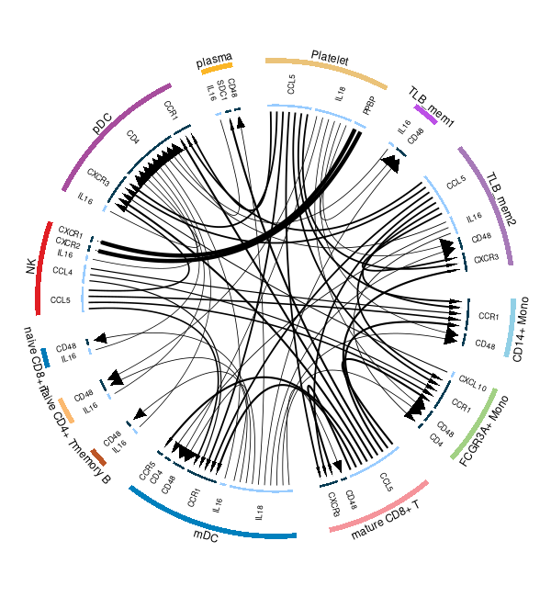
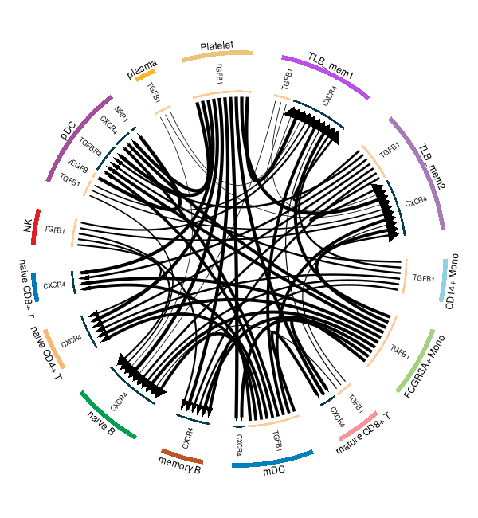
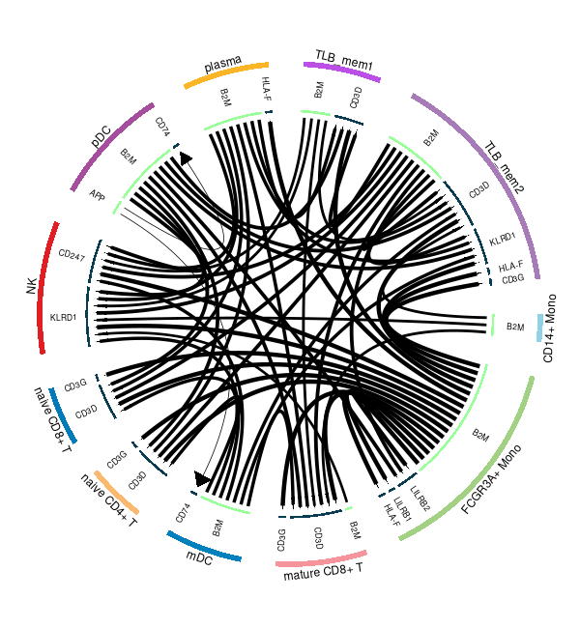
Cell-cell communication
We did not find something interesting from iTalk results
check points
cytokine
growth factor
other
Notes:
1)外圈是什么 2)里圈是什么 3)从A指到B的箭头是啥意思 4)粗细是啥意思 5)把TLB的位置高亮一下
强调checkpoint有immune checkpoint
Other是什么（主要强调是否可能有免疫相关的东西）
我们只是发现了TLB和B cell，T cell共享了一些信号通路，由于缺乏免疫学的知识和敏感度，不知道哪些信号通路是make sense的，还有一些没有可视化出来（太多了）
胡老师这边能不能提出一些他们认为非常感兴趣或者是关键的通路/受配体让我们又重点的去研究

Slide 22
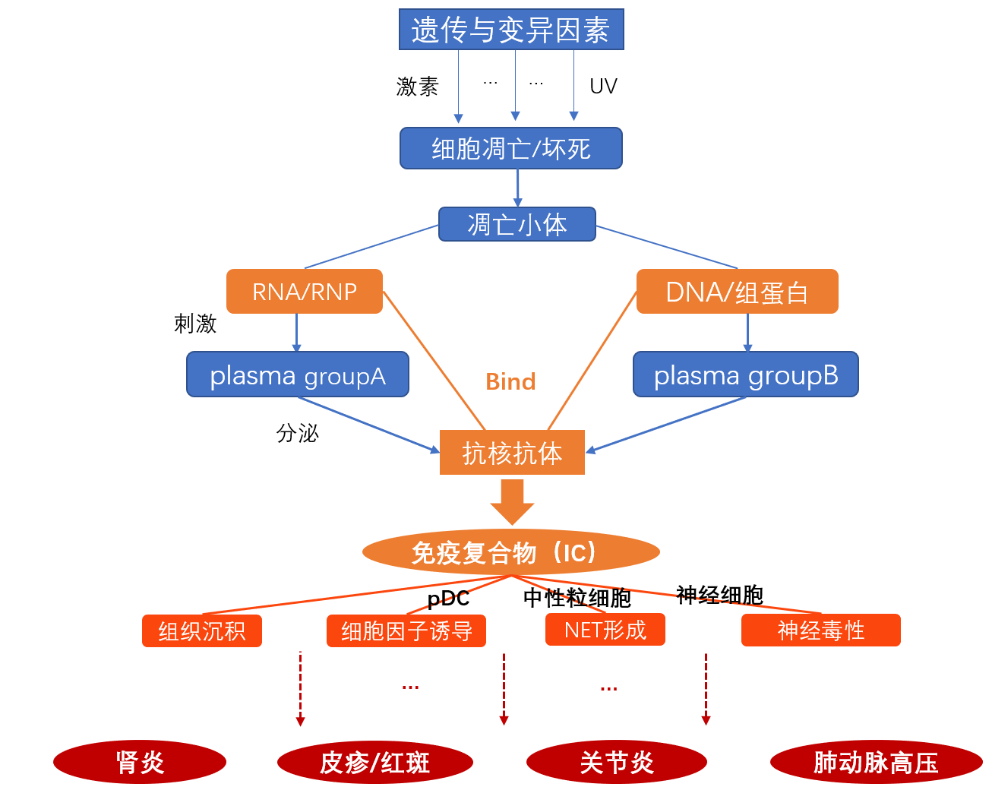
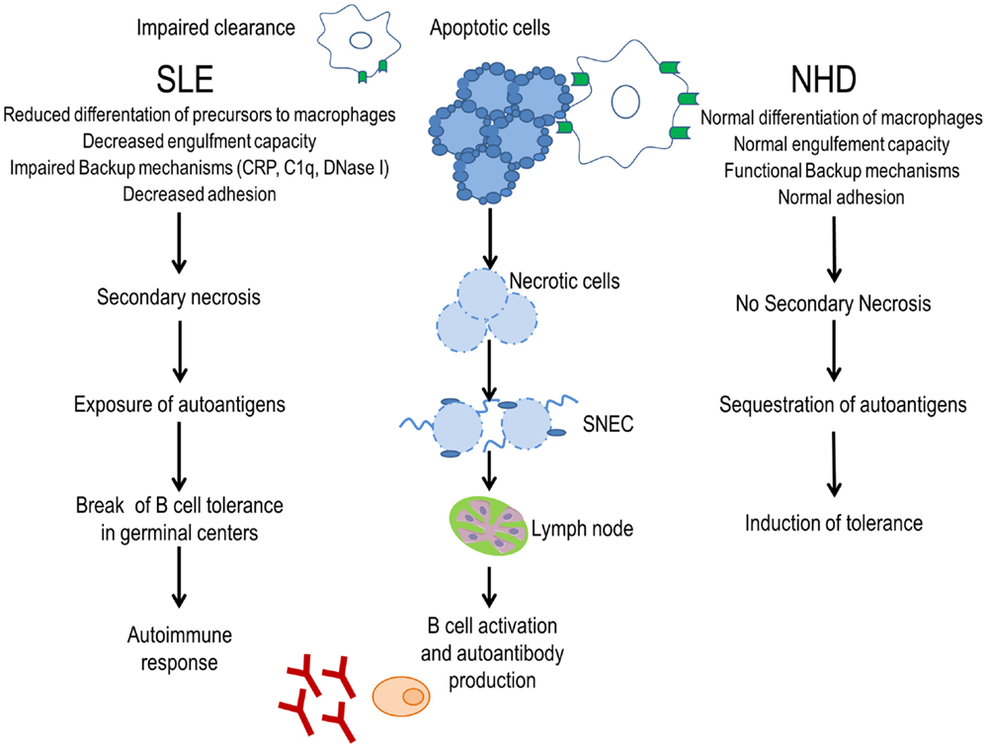
SLE_PAH 背景和潜在的发病机制

Slide 23
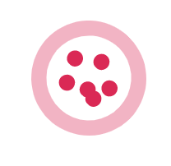
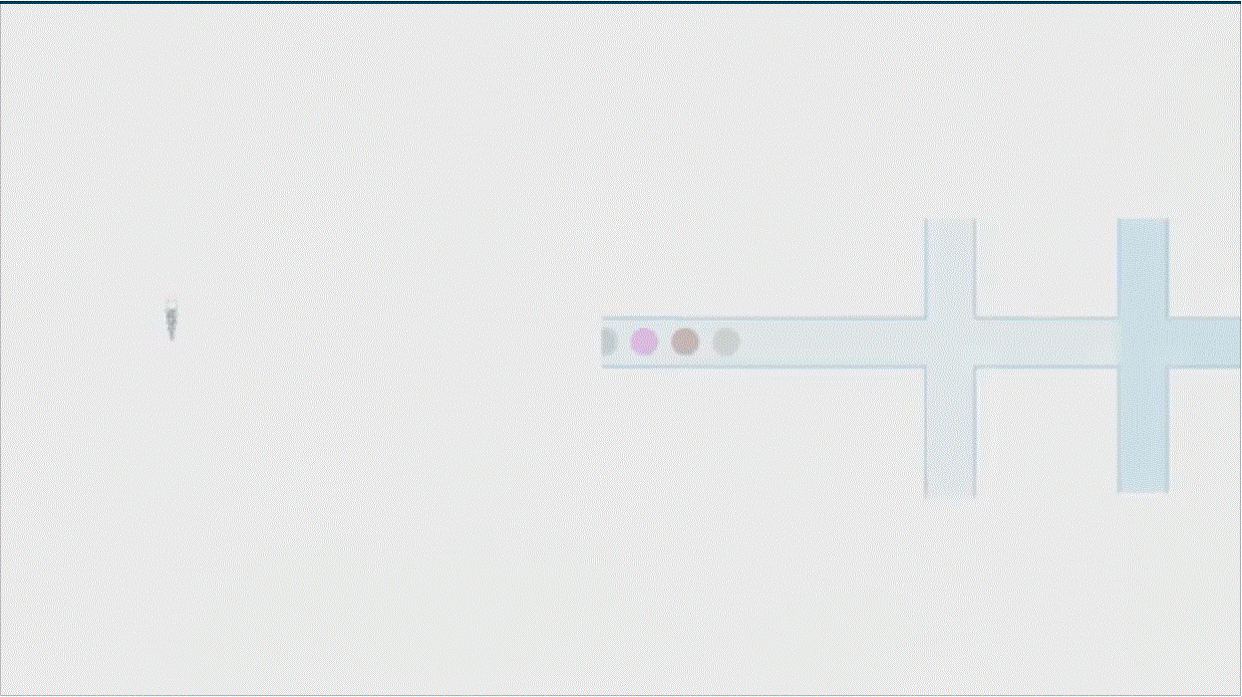


SLE_PAH单细胞项目设计
Gene expression
TCR repertoire
BCR repertoire
4 个分组，每组3个样本
细胞分群
Health
轨迹推断
总体分析
转录因子
免疫组库分析
SLE
SLE-PAH
组间差异基因
After treatment
细胞类群比例
组间对比
细胞通讯差异
TCR/BCR偏好性

Slide 24
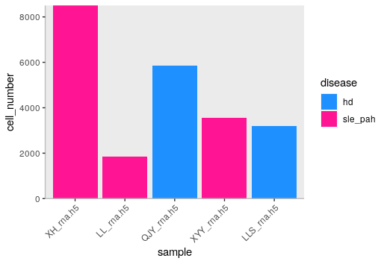
协和医院SLE_PAH项目数据（当前）
batch1
batch3
batch2
治疗前 2例 LL XH
SLE_PAH 3例
治疗后 1例 XYY (与治疗前XH配对)
健康对照 2例 成年女性 LLS QJY
pair
Notes:
22977

Slide 25
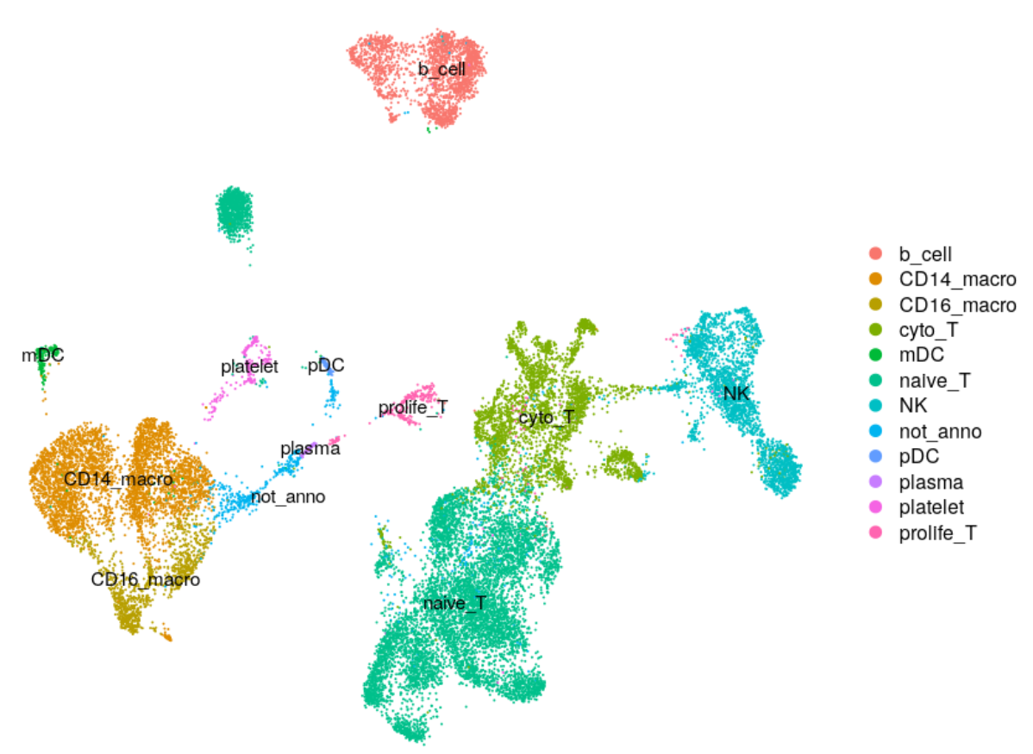
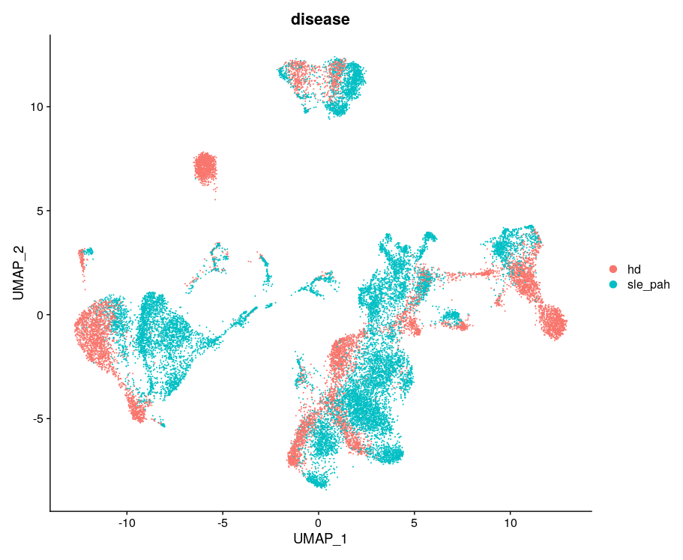
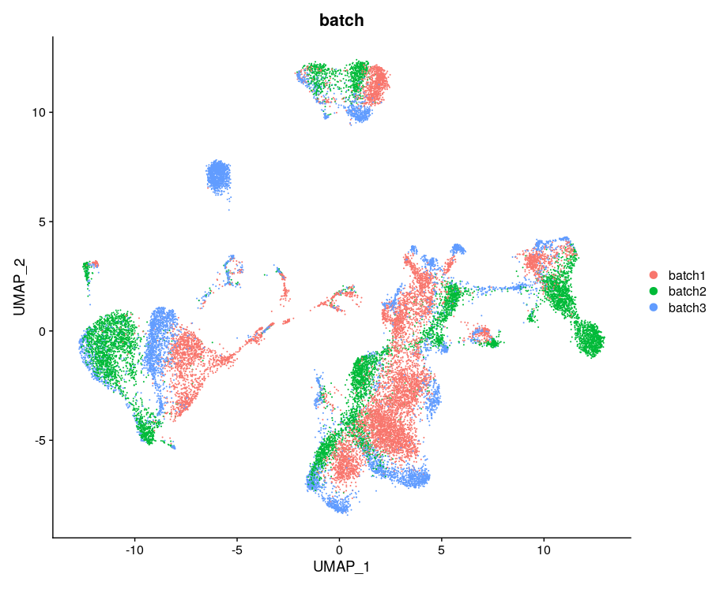
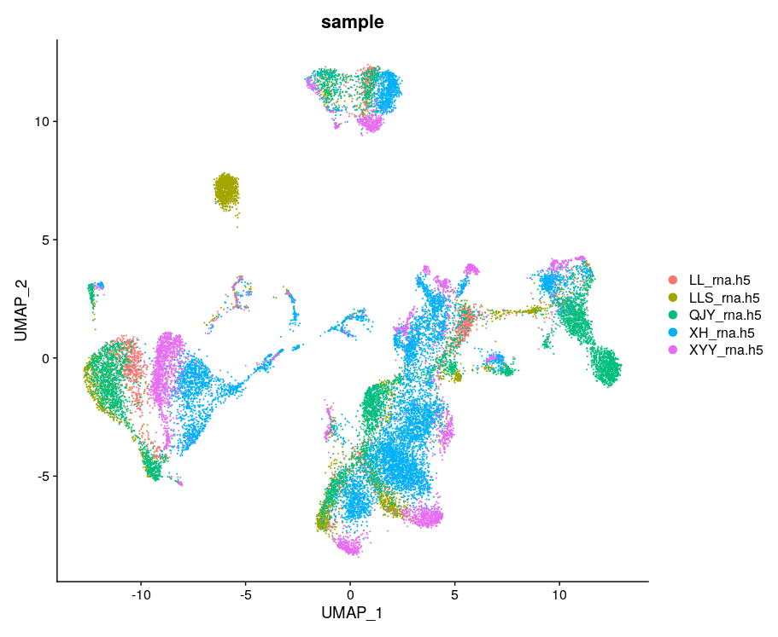
Whole PBMC
Notes:
现在暂时没有对每个病人的细胞类型的比例和动态变化进行分析，因为不同患者之间细胞数目差异过大，分析的结果可能不准确

Slide 26


Overview of PBMC cell type distribution
Group level
Sample level
Notes:
治疗前后直接看sample level就可以了，因为只有一个患者的数据

Slide 27





B cell analysis：2136 B cells
Notes:
The Role Of B Cells in Lupus Pathogenesis : https://www.ncbi.nlm.nih.gov/pmc/articles/PMC2835836/

Slide 28





B cell annotation and differentiation route prediction
Analysis via monocle3
Notes:
The Role Of B Cells in Lupus Pathogenesis : https://www.ncbi.nlm.nih.gov/pmc/articles/PMC2835836/
没有浆细胞的分析，因为5个患者加到一起只有不到100个浆细胞的数据

Slide 29


Sample level B cell analysis
Cluster 3: a new B cell subtype after treatment
we define cluster 3 as naïve B cell and compare it with naïve B before treatment (cluster 0 )

Slide 30




T cell analysis:
Notes:
The Role Of B Cells in Lupus Pathogenesis : https://www.ncbi.nlm.nih.gov/pmc/articles/PMC2835836/

Slide 31

T cell analysis:
Notes:
The Role Of B Cells in Lupus Pathogenesis : https://www.ncbi.nlm.nih.gov/pmc/articles/PMC2835836/

Slide 32


Sample level T cell analysis:
?
Notes:
The Role Of B Cells in Lupus Pathogenesis : https://www.ncbi.nlm.nih.gov/pmc/articles/PMC2835836/

Slide 33


Compare SLE_PAH with HD in T cell
time

Slide 34





Monocyte analysis:

Slide 35


Compare SLE_PAH with HD in Monocyte

Slide 36
Other cell type analysis: waiting more data
Plasma: 87
pDC: 101
mDC: 203
Platelet: 224

Slide 37





BCR repertoire
BCR repertoire difference between the SLE patient and a health people
All B cell BCR distribution
Unique BCR distribution
Clonotypes
CDR3 length distribution
Notes:
BCR 分布，但是是基于一个病人的数据，所以可能缺乏统计效力，良好的实验设计
（是否需要补充背景知识）

Slide 38





TCR repertoire
TCR repertoire difference between the SLE patient and a health people
All T cell BCR distribution
Unique TCR distribution
Clonotypes
CDR3 length distribution
Notes:
测序质量略低是因为还有cite-seq的数据，也就是说3个组学

Slide 39






BCR and TCR of TLB
TLB immune repertoire difference between the SLE patient and a health people
BCR of TLB
TCR of TLB
Notes:
测序质量略低是因为还有cite-seq的数据，也就是说3个组学

Slide 40



TCR and BCR distribution of different TLB sub types in SLE patient
TLB_mem1
TLB_mem2
TLB_plasma
Notes:
一件非常有趣的事情是3种TLB亚型在TCR 和BCR中的分布各有特点
之后会通过更大队列的数据（公共）来证实这个结论

Slide 41
Thanks

